Slide 1
myKOKO promotions requirements scoping V2
Terry Karungi and Peter Mwangi
Software Product team
21 Aug 2017

Slide 2
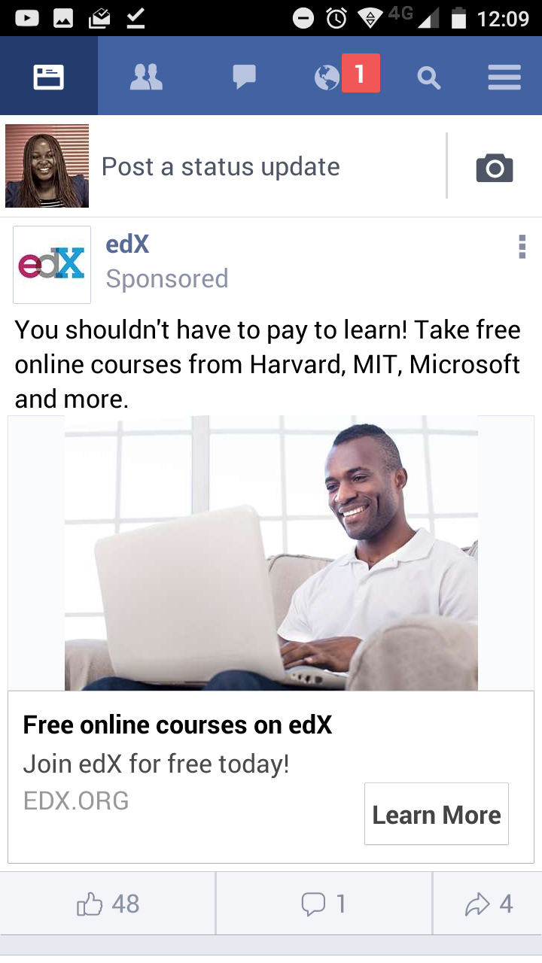
Facebook sponsored promotion
Summary
Captivating promo Image
Title
User call to action
User engagement

Slide 3
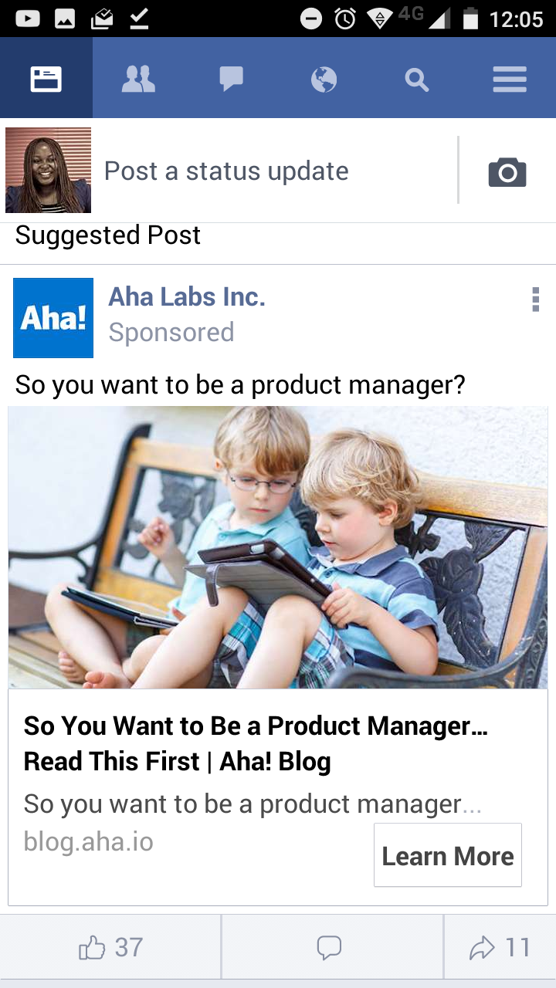
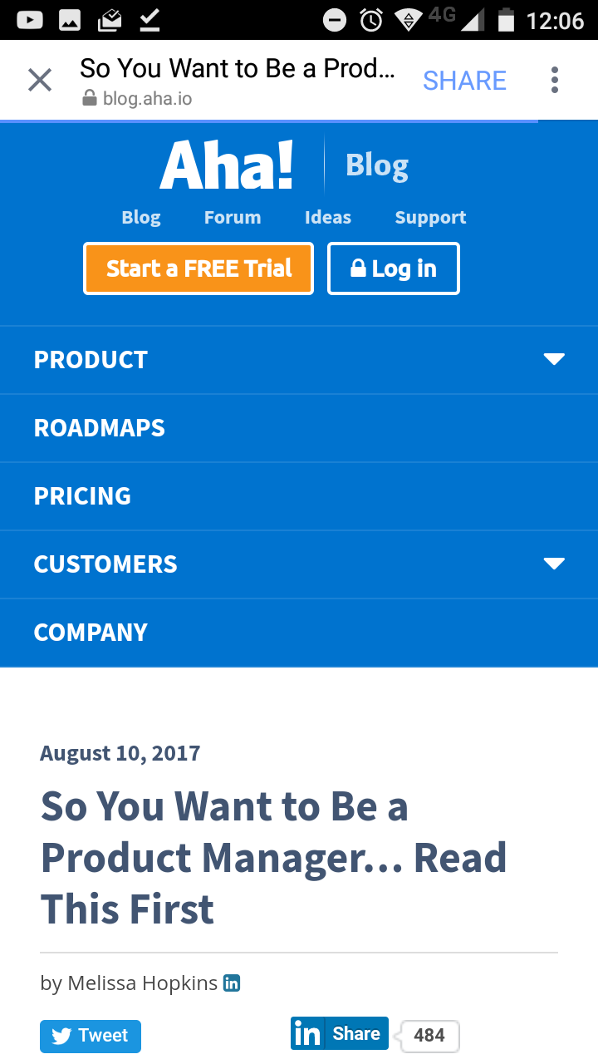
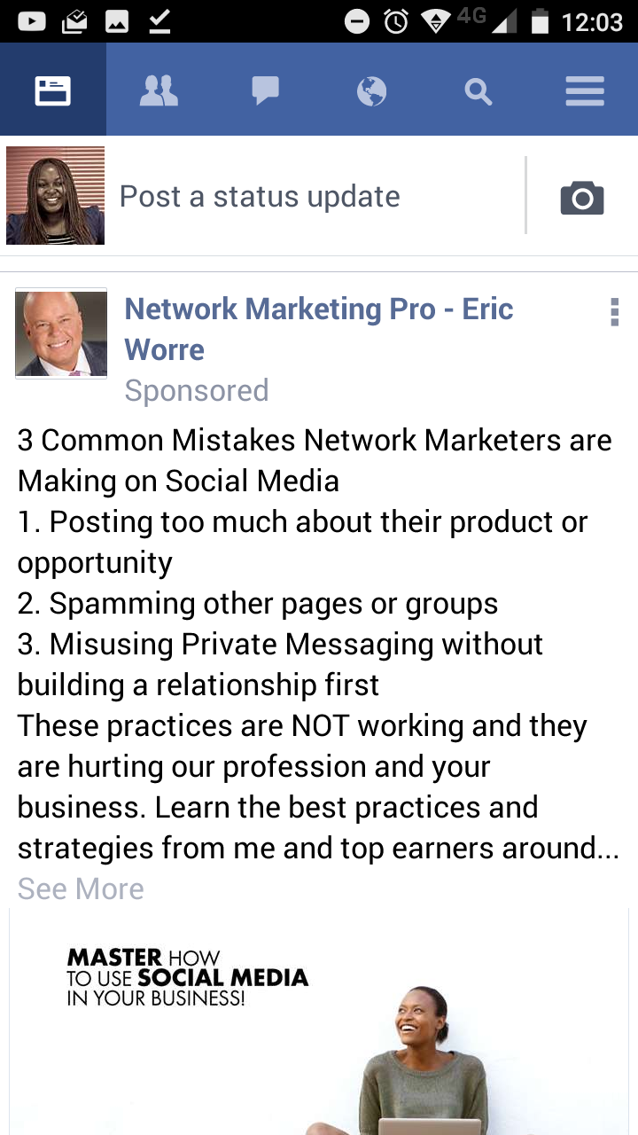
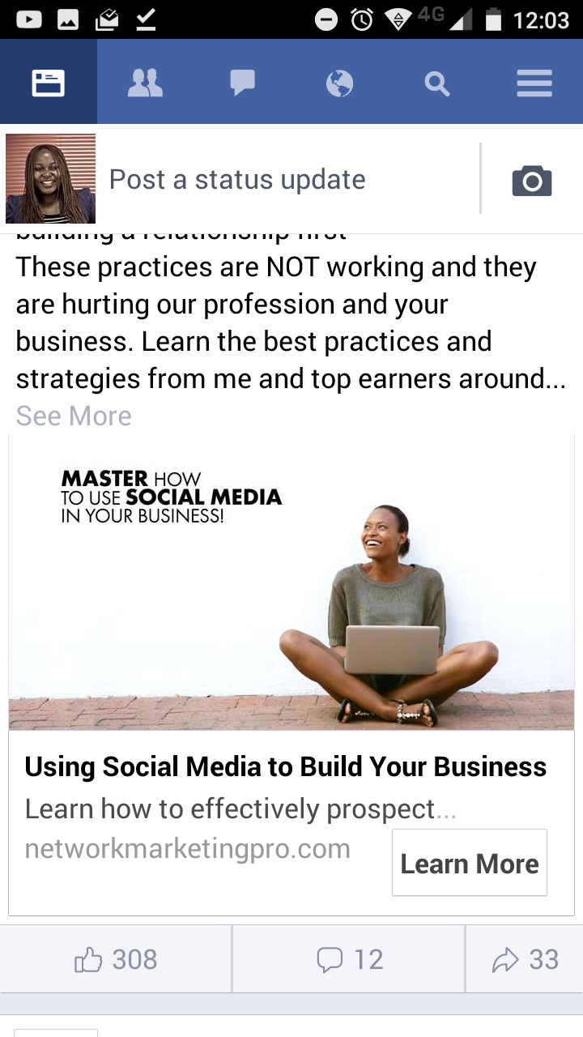
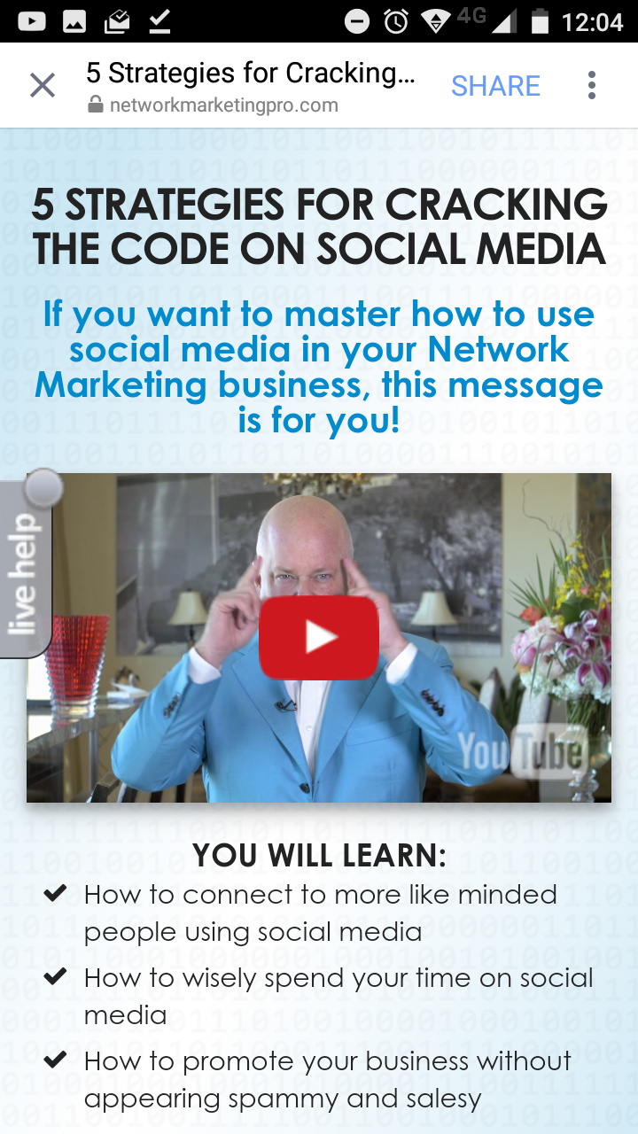
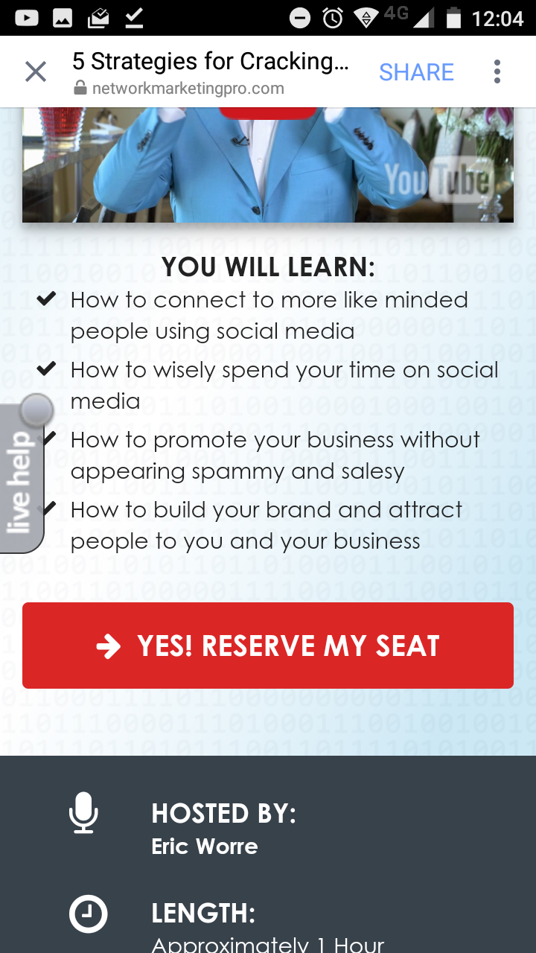
Facebook sponsored promotion - examples

Slide 4
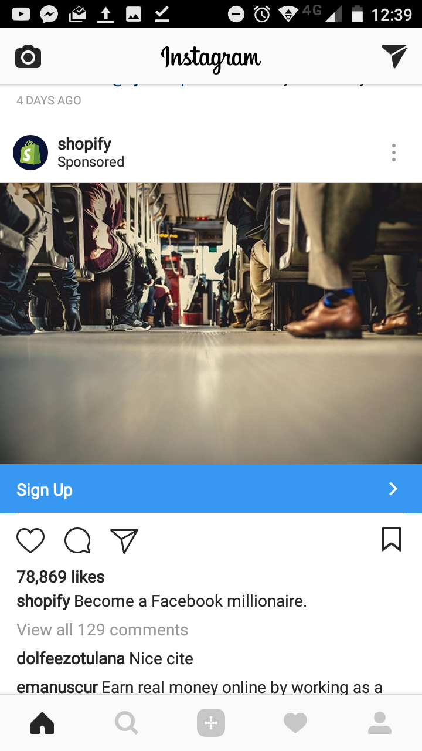
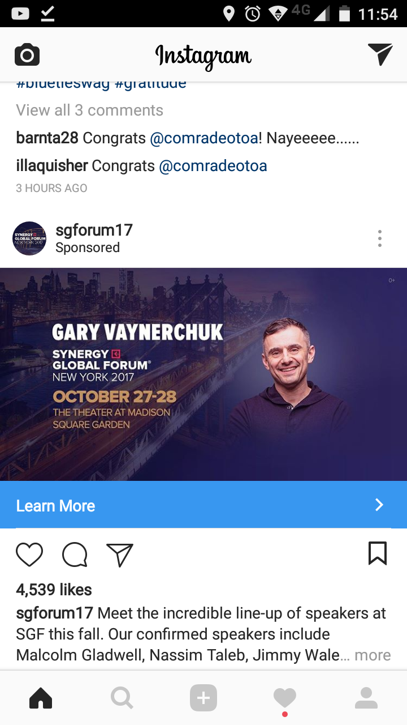
Instagram sponsored promotion
Captivating promo Image
User call to action
User engagement
Summary

Slide 5
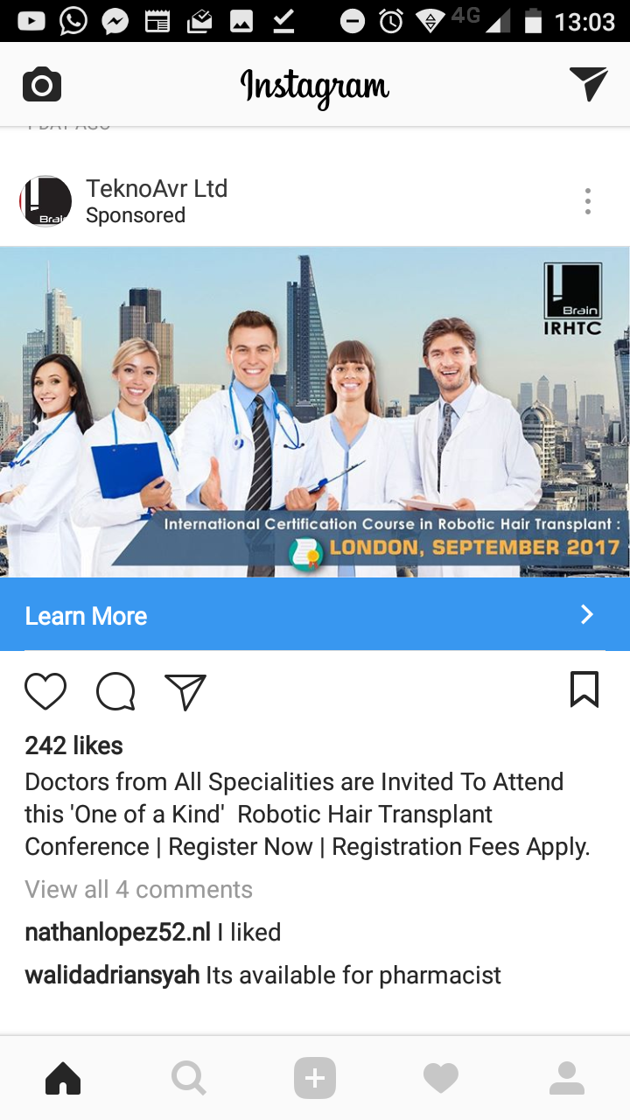
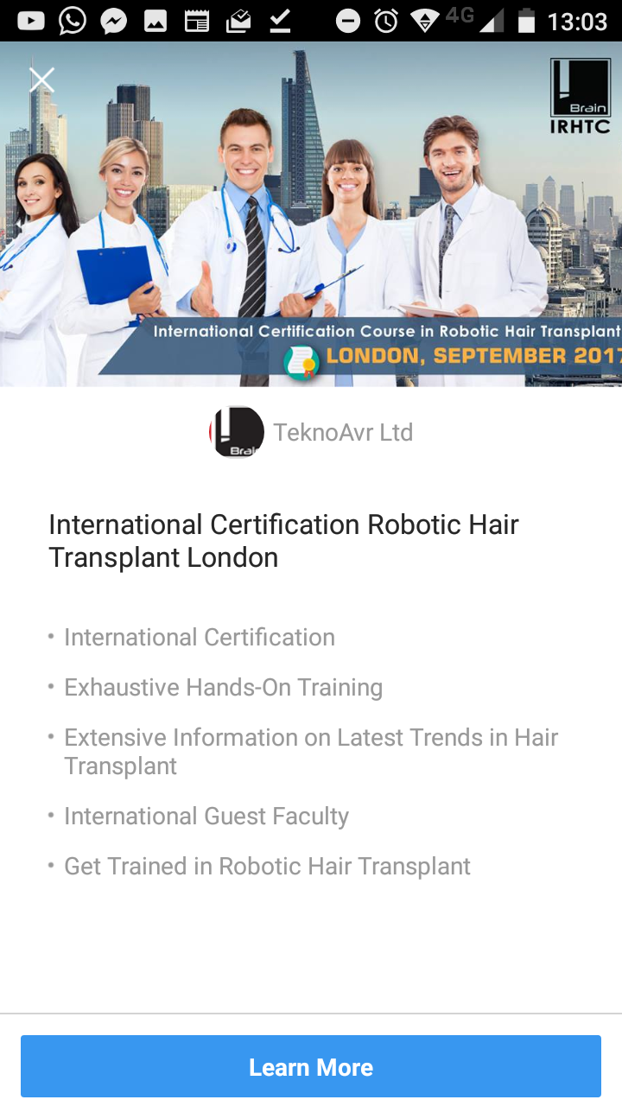
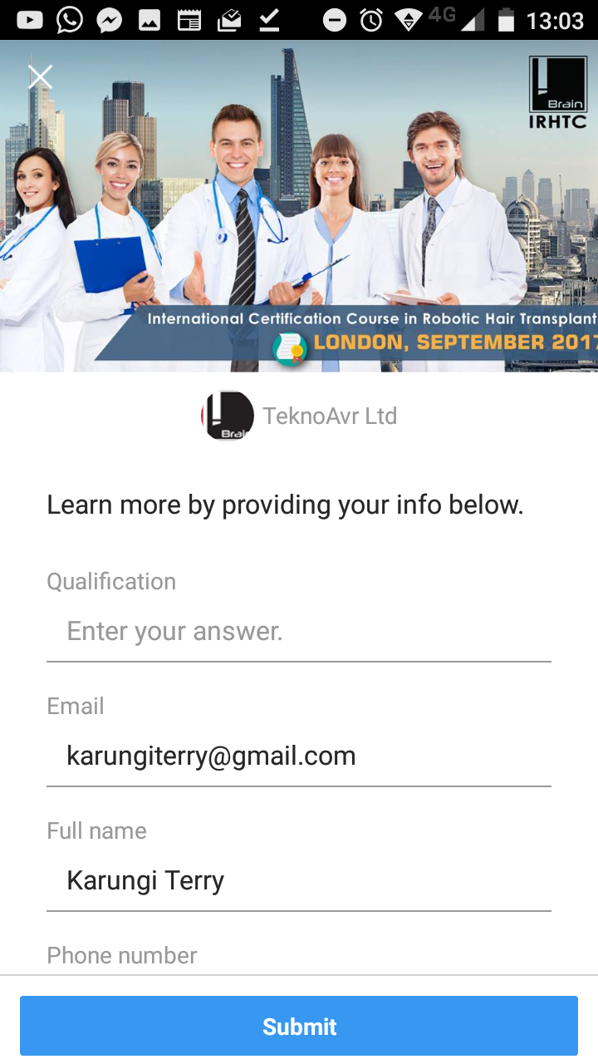
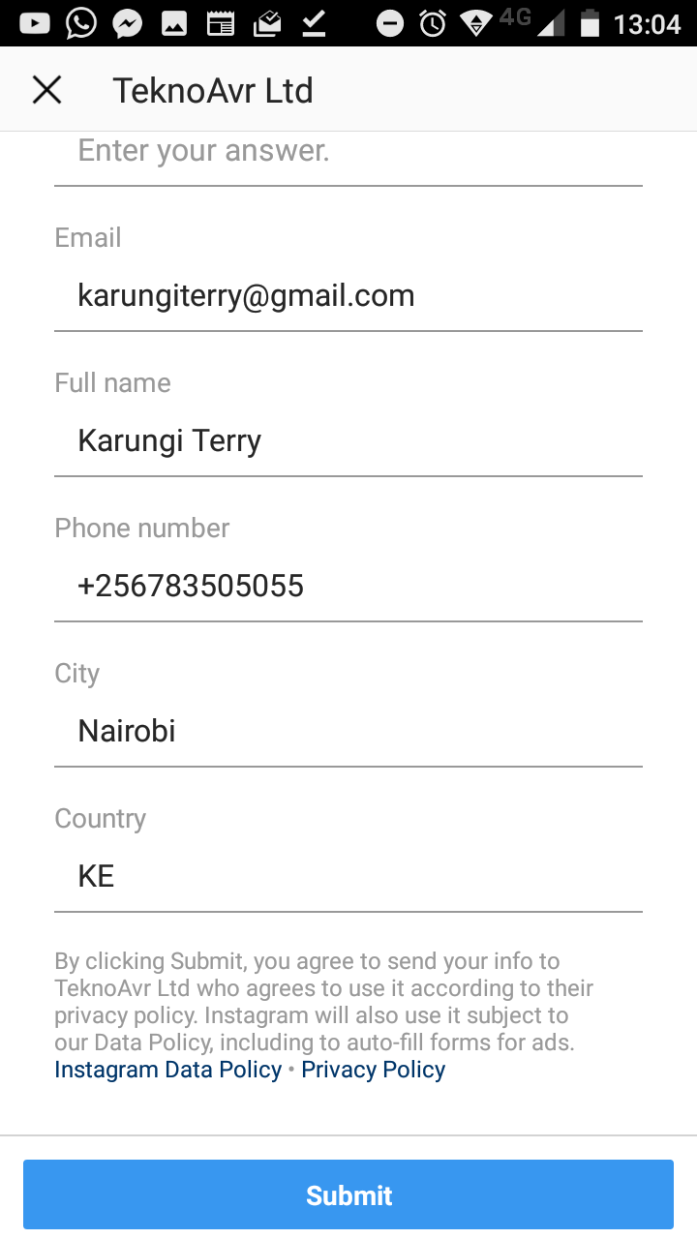
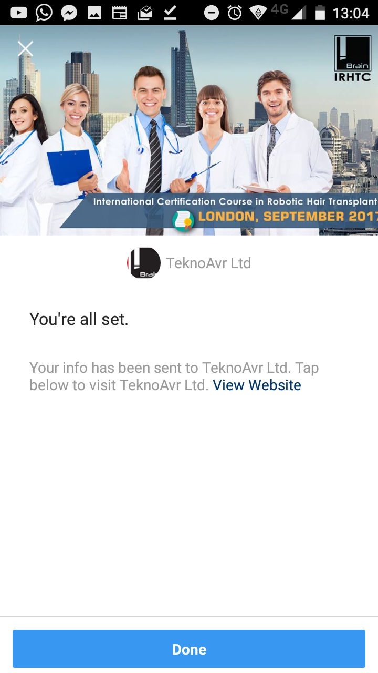
Instagram sponsored promotion - example

Slide 6
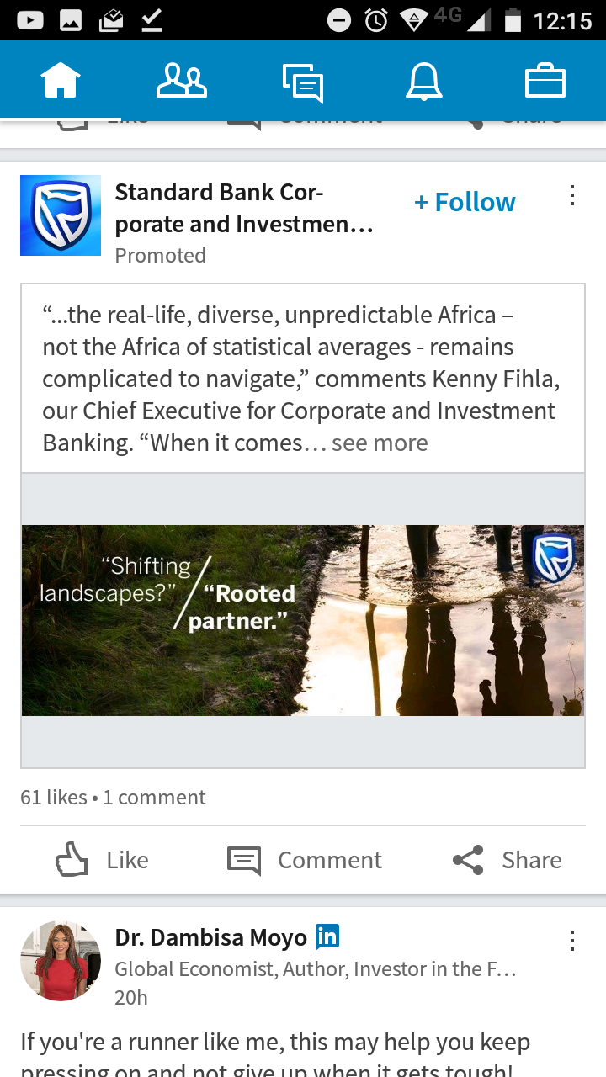
LinkedIn sponsored promotion
User call to action
Summary
Captivating promo image
User engagement

Slide 7
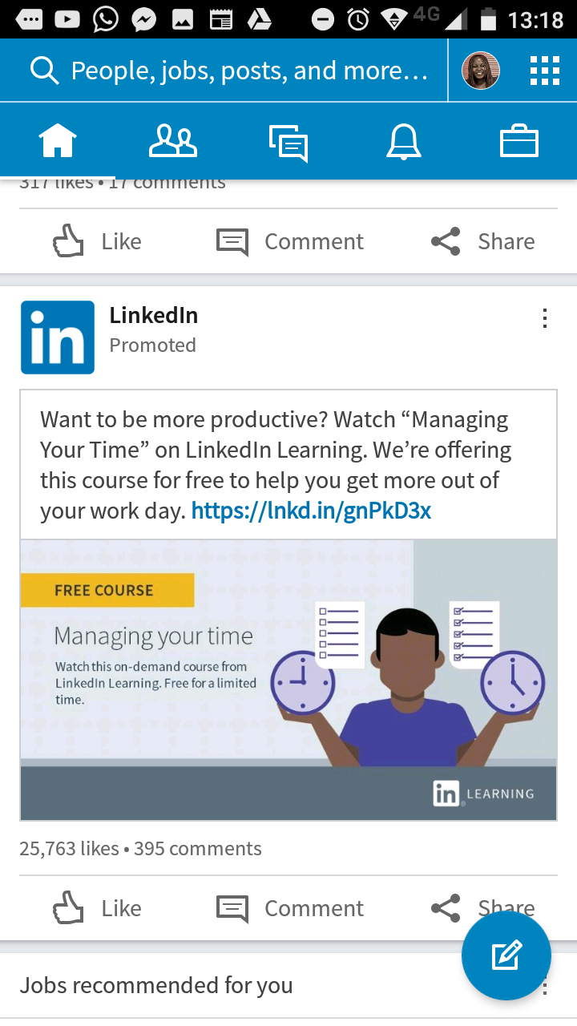
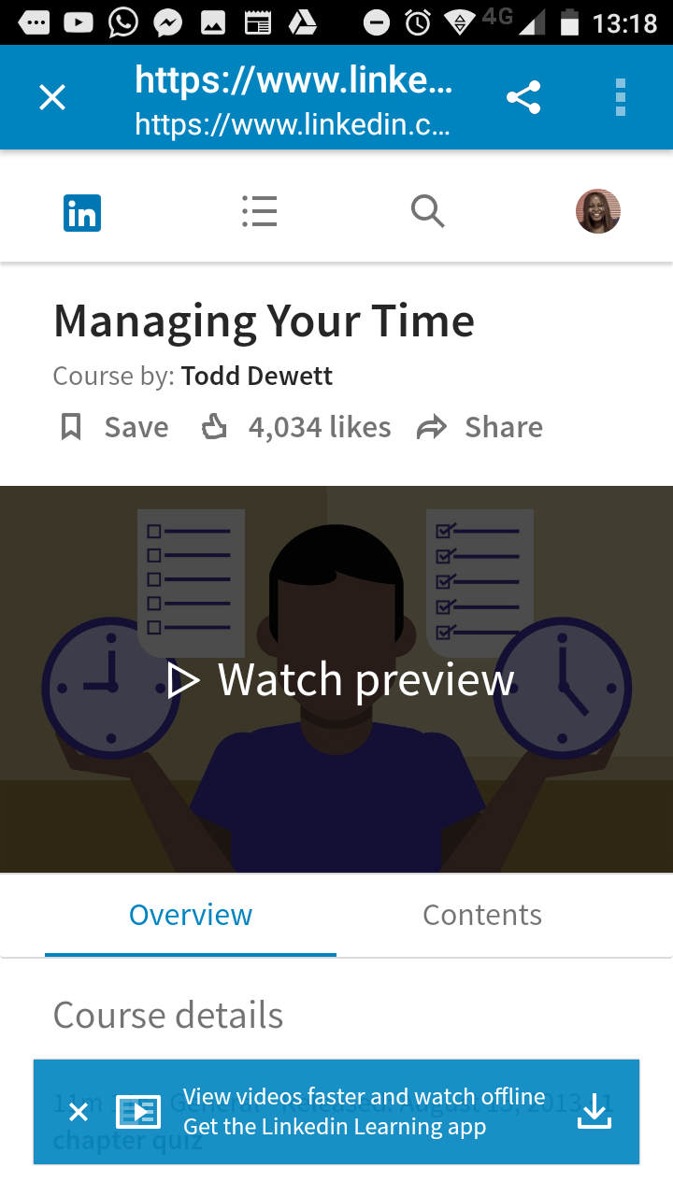
Linkedin sponsored promotion - example

Slide 8
myKOKO
?
Ideas to add to myKOKO
Ability to share the promotion
Promotion likes
Promotion image
Promotion description/title/terms and conditions

